Slide 1
Weeks 9&10 Exercise
Andrea Fox
February 14, 2021
DSC640 – T301 Data Presentation & Visualization

Slide 2
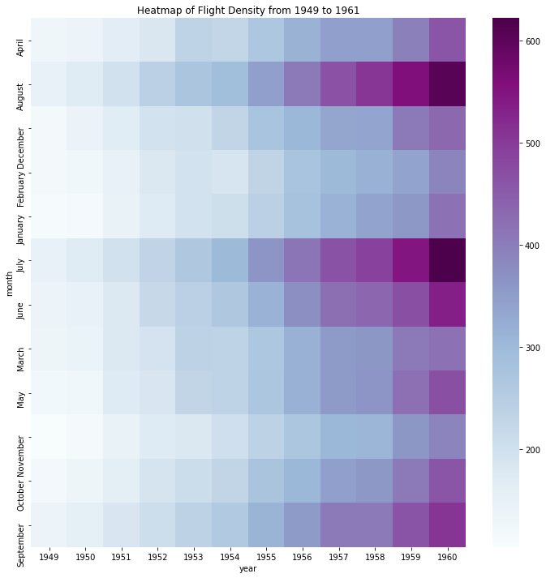
Python – Heat Map

Slide 3
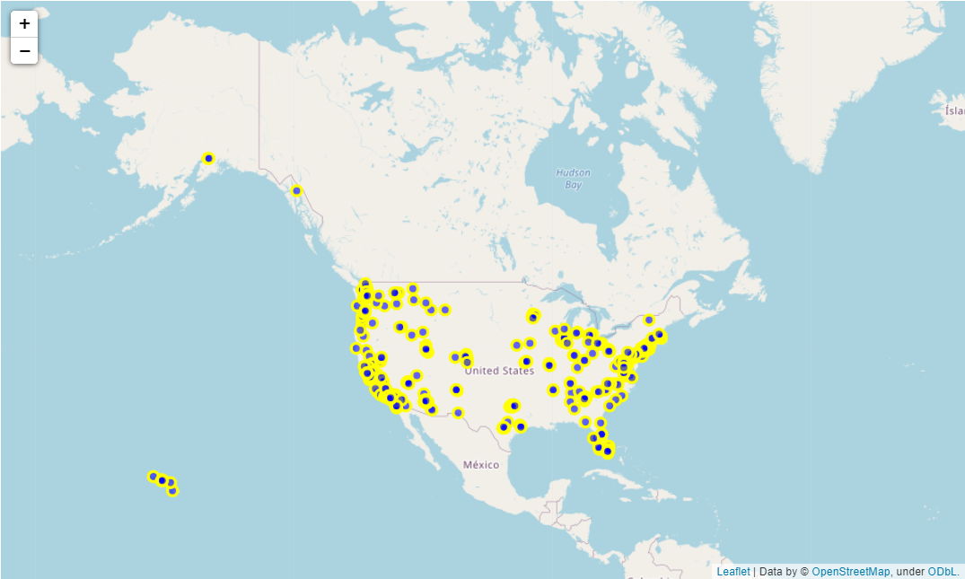
Python – Spatial Chart

Slide 4
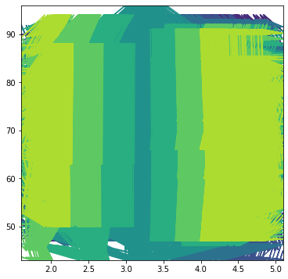
Python – Contour Plot

Slide 5
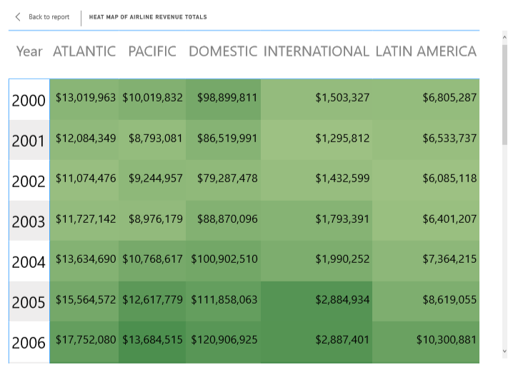
Power BI – Heat Map

Slide 6
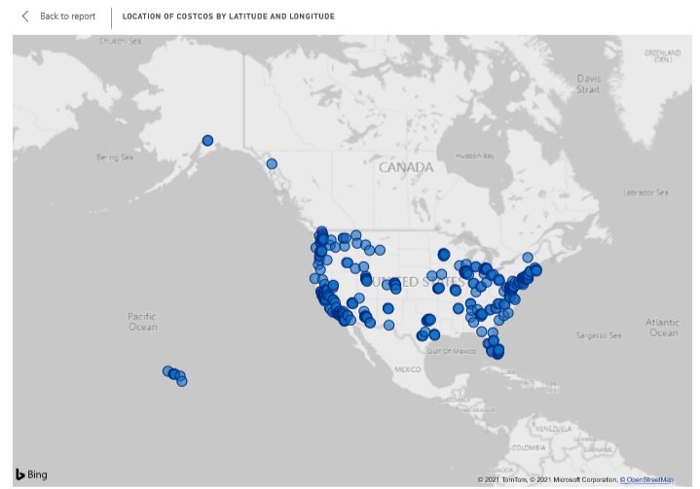
Power BI – Spatial Chart

Slide 7
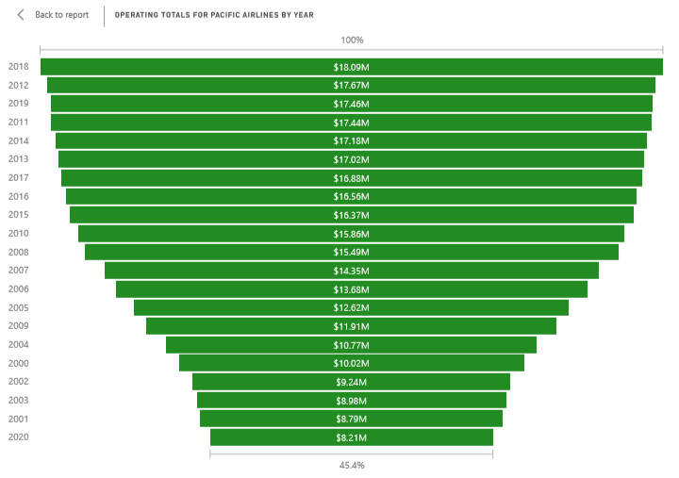
Power BI – Funnel Chart

Slide 8
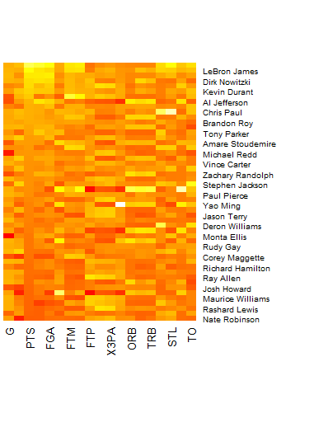
R – Heat map

Slide 9
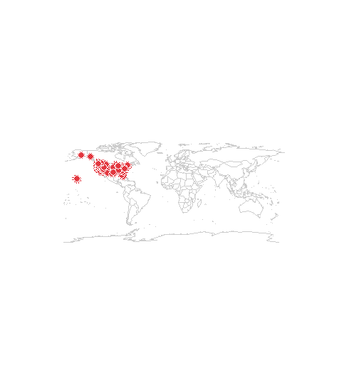
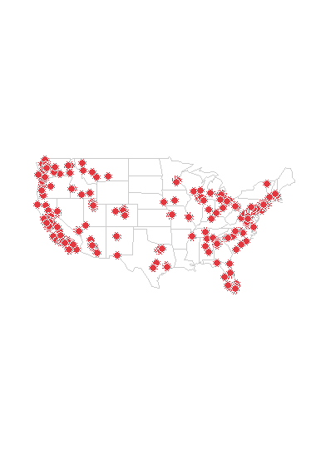
R – Spatial Plot

Slide 10
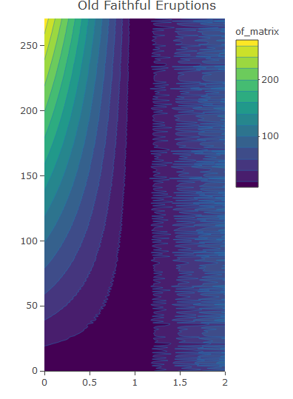
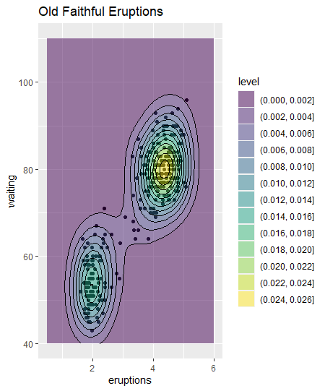
R – Contour Plot

Slide 11
Additional Notes
So, on the contour chart I definitely struggled mostly in Python. I added a note to the code, but also wanted to include it here. I used the same dataset for the contour chart for both R and Python, but the python one just didn’t come out how I wanted it to. Since I’m turning this in late due to bereavement, I wanted to get it turned in and not spend more time playing with it since I’m not sure where to begin. I’d love some ideas though if you could share.

Slide 12
References
Used the NBA and Costco datasets that were part of the downloads
Old Faithful dataset that was found here – https://www.kaggle.com/janithwanni/old-faithful
Flights dataset found here - https://github.com/AlgorexHealth/python-viz-compared/blob/master/data/flights.csv
Python Heat map reference - https://blog.algorexhealth.com/2017/09/10-heatmaps-10-python-libraries/
Python spatial plot reference - https://thecleverprogrammer.com/2020/08/15/visualize-geospatial-data/
Python contour plot reference - https://jakevdp.github.io/PythonDataScienceHandbook/04.04-density-and-contour-plots.html
Power BI heat map reference - https://www.tutorialgateway.org/heat-map-in-power-bi/
R heat map reference - https://flowingdata.com/2010/01/21/how-to-make-a-heatmap-a-quick-and-easy-solution/
R contour reference - https://ggplot2.tidyverse.org/reference/geom_density_2d.html and https://plotly.com/r/contour-plots/#reference

